Slide 1




How to write a scientific article
Constantinos (Dinos) Mylonas
Director
Institute of Marine Biology, Biotechnology & Aquaculture
Crete, Greece
mylonas@hcmr.gr

Slide 2
How to write a scientific article
Outline of todays presentation
Preparation of a manuscript
  Format
  Parts
  Contents
  References
  Tables and Graphs
Language use and common errors
References and Bibliographic software
Table of Contents
Review process

Slide 3
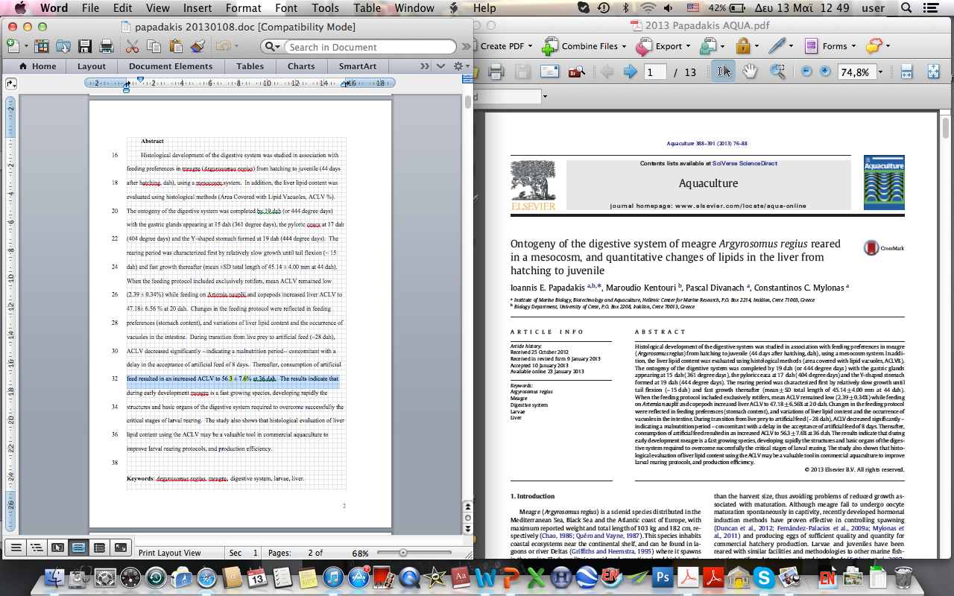
Format – page width and columns
Manuscript and published article have very different formats!
Manuscript
Article
Pay attention to the width of the journal, it will help you prepare your figures/photos/etc.
Notes:
Manuscript and final version is the same, so don’t try to replicate what you see printed. BUT pay attention to the size of the page of each journal, and especially the width, as this will affect the way tour figures are treated.

Slide 4
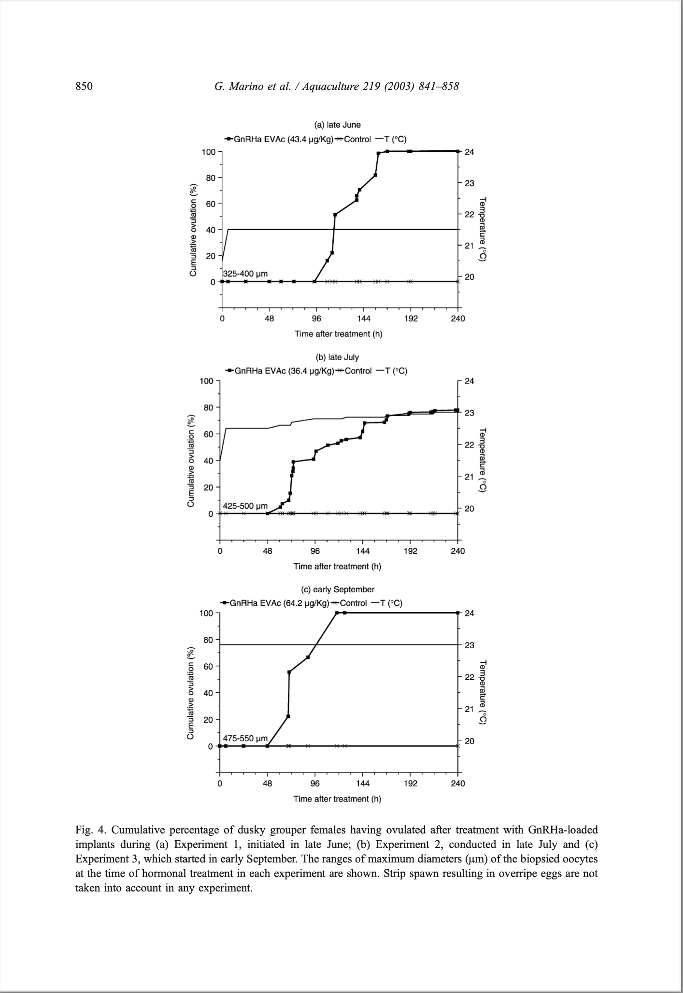
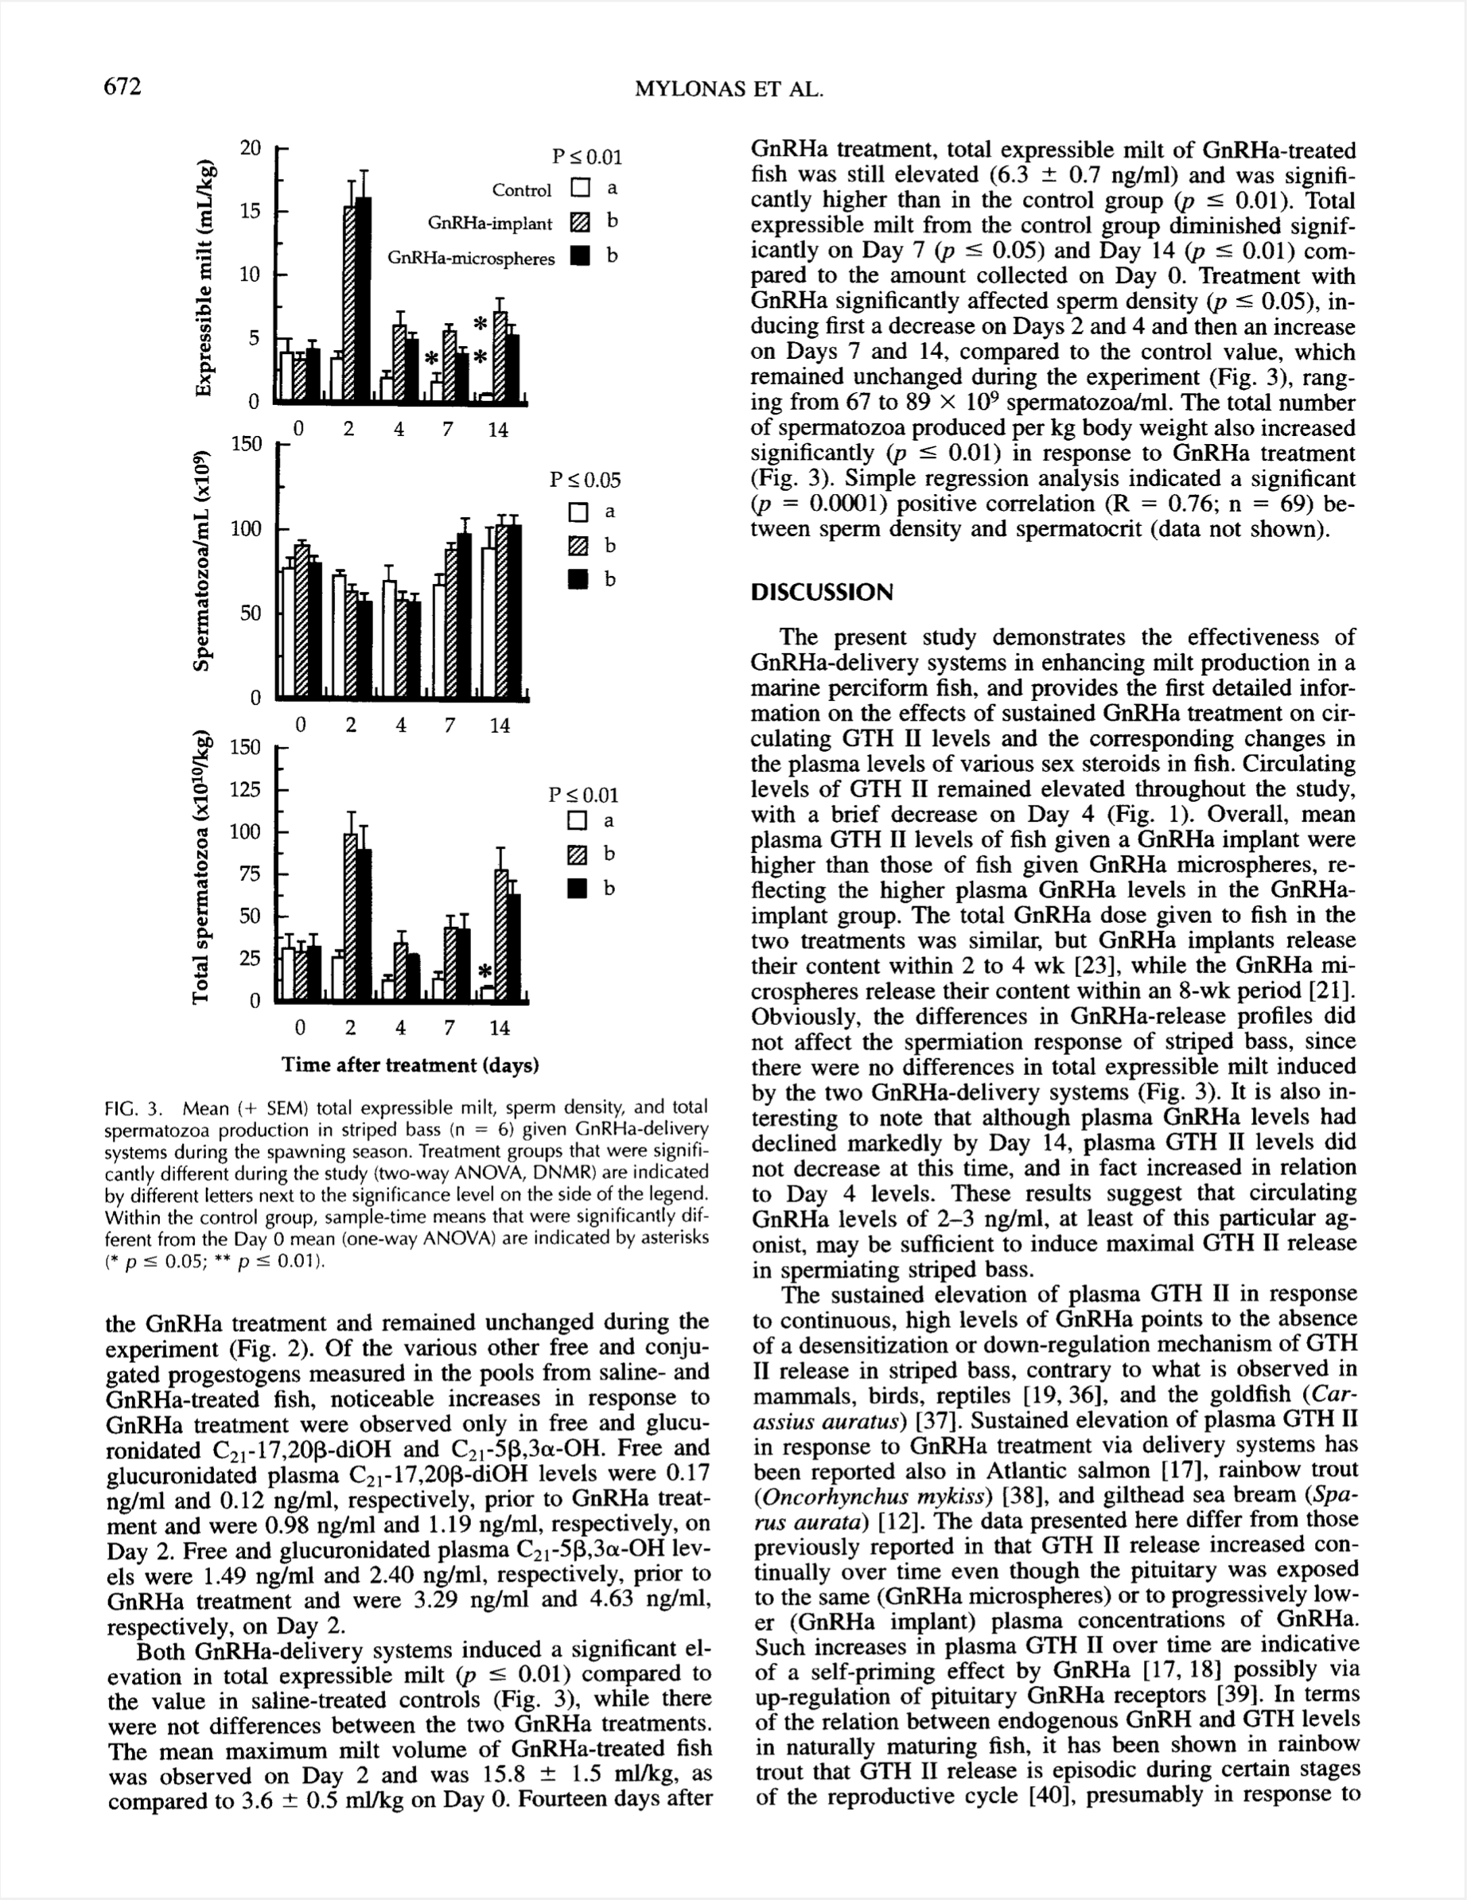
Format – page width and columns
Pay attention to the width of the journal, it will help you prepare your figures/photos/etc.
Notes:
Manuscript and final version is the same, so don’t try to replicate what you see printed. BUT pay attention to the size of the page of each journal, and especially the width, as this will affect the way tour figures are treated.

Slide 5
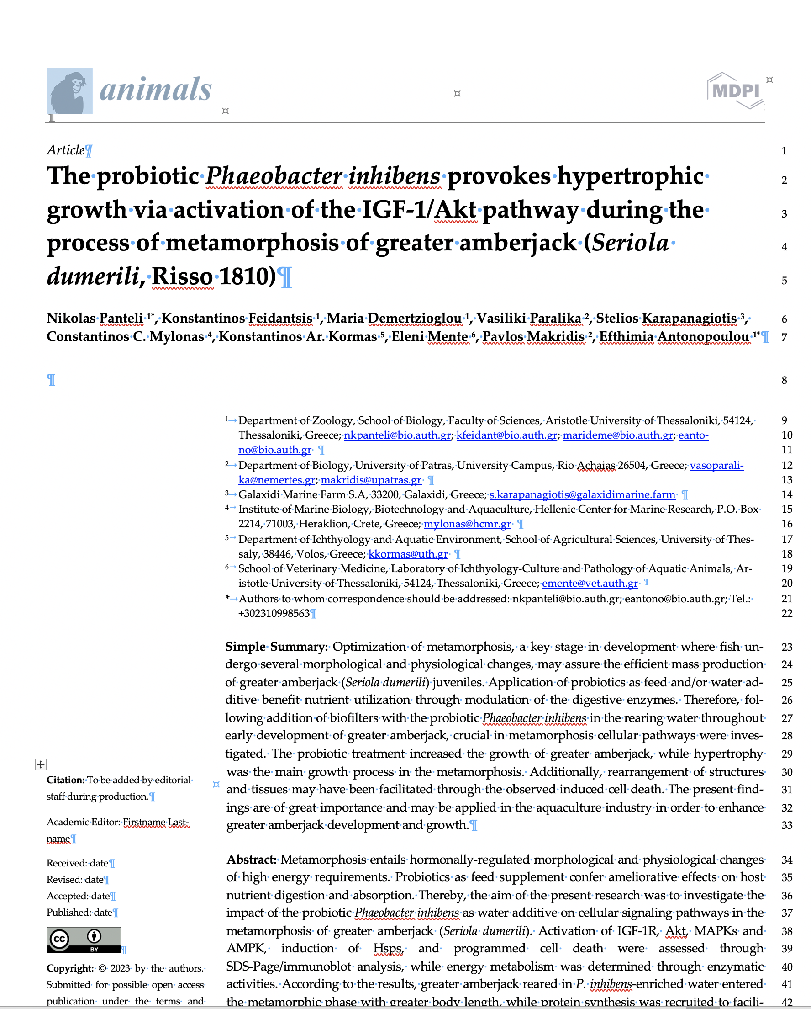
Format
Recently, some journals give you the MS Word format to prepare the manuscript exactly as it would appear, thus saving money in typesetting
Examples
Notes:
Some online journals, give you the MS Word file to prepare the manuscript exactly as it will appear in the on line version, this saving money on print setting.

Slide 6
Structure - Article
Title page
Abstract
Introduction
Materials and Methods
Results
Discussion
Acknowledgements
References
Tables
List of Figures
Figures
Typical - traditional format (printed)
but
With internet submission/viewing many things changed (e.g. M&M, Results at the end, Figures on the side, Supplementary data, etc.)
Notes:
This is the typical and historical structure of a manuscript submitted for review. However, recently there new sections that may be required, or the order of sections is different (Discusion first, M&M last)

Slide 7
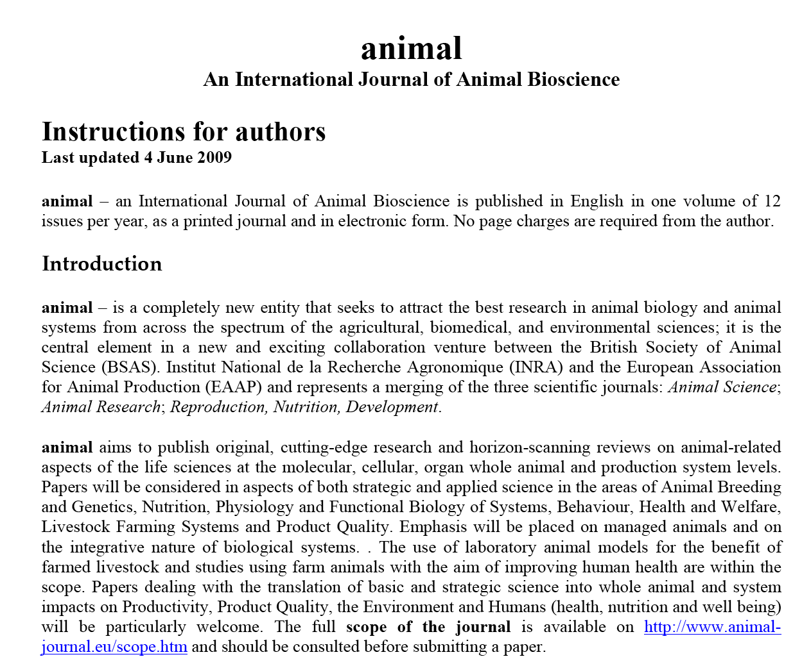
Structure – Instructions to authors
Pay very careful attention before you even start writing the manuscript!!!!!

Slide 8
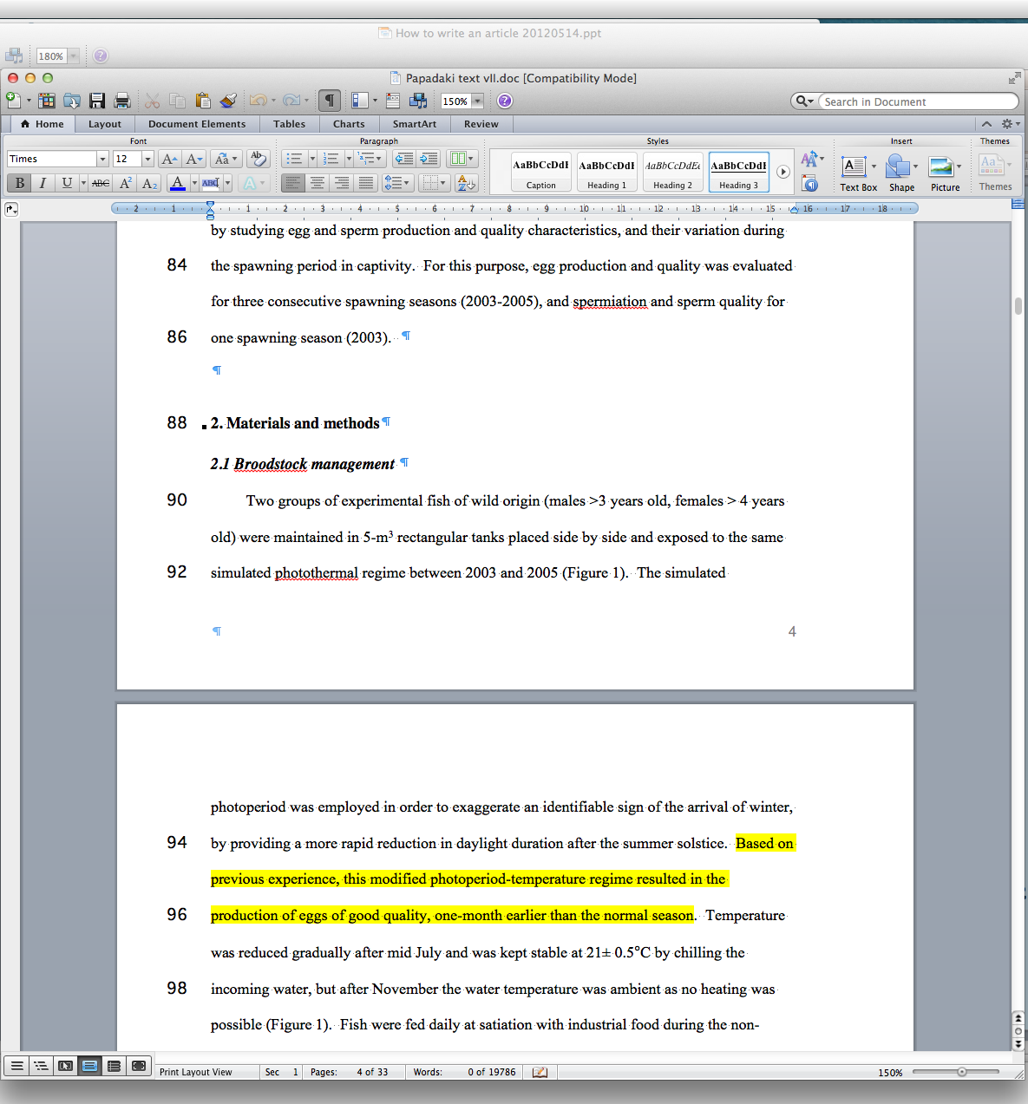
Format - Instructions to authors
Margins
  Left, right, top, bottom
Spacing
  Double space
Font type and size
  Arial or Times
Line numbers
  Every other (1, 3, 5)
Levels of organization
  Not more than three (2 better)
    1. Introduction
    2. Materials and Methods
      2.1. Experimental animals
      2.2. Experimental design
        2.2.1. Effect of season on reproduction

Slide 9
Structure - Manuscript
Title page
Abstract
Introduction
Materials and Methods
Results
Discussion
Acknowledgements
References
Tables
List of Figures
Figures
Notes:
So, this is the typical structure of the manuscript

Slide 10
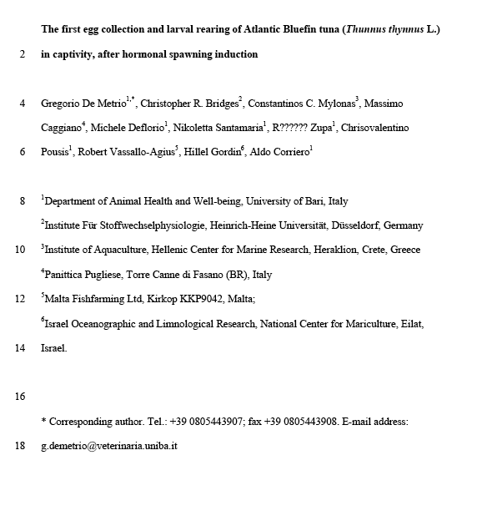
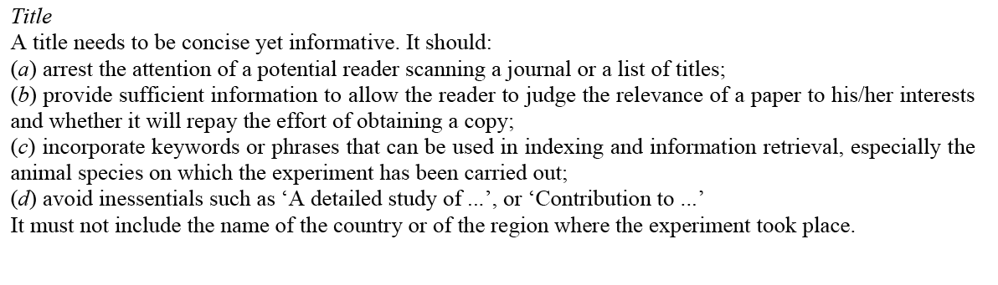
Structure – Title page
Title page (1 page)
Abstract
Introduction
Materials and methods
Results
Discussion
Acknowledgements
References
Tables
Figures legends
Figures

Slide 11
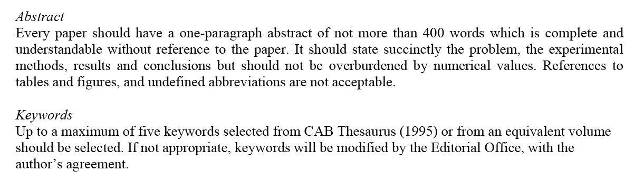
Structure - Abstract
Title page (1 page)
Abstract (1 page)
Introduction
Materials and methods
Results
Discussion
Acknowledgements
References
Tables
Figures legends
Figures

Slide 12
Structure - Introduction
Title page (1 page)
Abstract (1 page)
Introduction (2-3 pages)
Materials and methods
Results
Discussion
Acknowledgements
References
Tables
Figures legends
Figures
- Presentation of the problem
- Current knowledge or situation
- Relevant knowledge from other species
- Objectives of the study

Slide 13
Structure – Materials and Methods
Title page (1 page)
Abstract (1 page)
Introduction (2-3 pages)
Materials and methods (n pages)
Results (n pages)
Discussion
Acknowledgements
References
Tables
Figures legends
Figures
Objectives
Understand the study
Evaluate the results
Repeat if required
Content (chronological order)
- Experimental animals or site
- Experimental design
- Data collection
- Analytical methods (hormone assays, molecular methods, measurements, etc.
- Statistical analysis

Slide 14
Structure – Materials and Methods
Title page (1 page)
Abstract (1 page)
Introduction (2-3 pages)
Materials and methods (n pages)
  Ethics declaration
Results (n pages)
Discussion
Acknowledgements
References
Tables
Figures legends
Figures
Ethics declaration !!!!
Approval by experimental animal committee (internal and/or external
Approval of the “Ethics Committee” (Internal)
Obtained BEFORE starting the experiment, not when writing the manuscript!!!!!
Notes:
Here we talk for the first time about Experimental animals!!! Must be obtained before we start the experiment, not when writing the article!!!

Slide 15
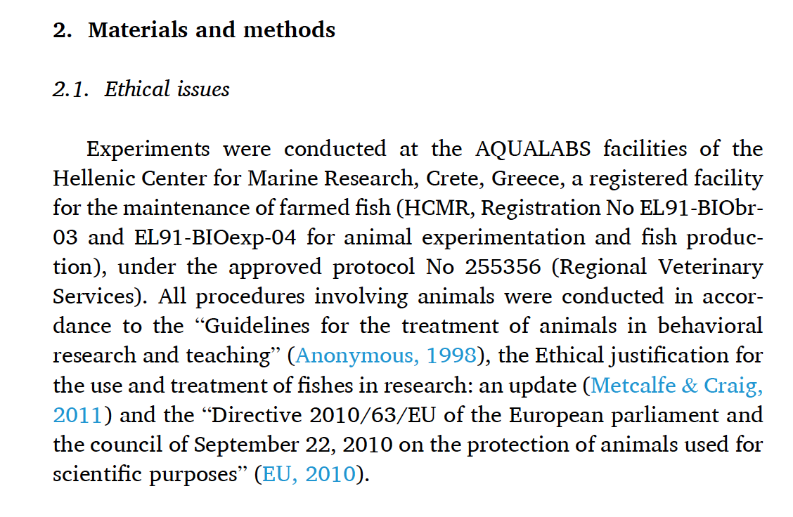
Structure – Materials and Methods
Title page (1 page)
Abstract (1 page)
Introduction (2-3 pages)
Materials and methods (1-n pages)
  Ethics declaration
Results (n pages)
Discussion
Acknowledgements
References
Tables
Figures legends
Figures

Slide 16
Structure – Results
Title page (1 page)
Abstract (1 page)
Introduction (2-3 pages)
Materials and methods (n pages)
Results (n pages)
Discussion
Acknowledgements
References
Tables
Figures legends
Figures
Presentation of results in a chronological order
Reference to Tables and Figures
Absolutely NO discussion (no opinions or conclusions) unless some of the results have lead to another experiment/analysis not planned originally

Slide 17
Structure – Discussion
Title page (1 page)
Abstract (1 page)
Introduction (2-3 pages)
Materials and methods (n pages)
Results (n pages)
Discussion (3-n pages)
Acknowledgements
References
Tables
Figures legends
Figures
Interpretation of results
Comparison with other studies
NO reference to results, tables and figures, unless new (model) or for comparison purposes
Significance of the study, contribution to the field
Suggestions for further work
Conclusions

Slide 18
Structure – Acknowledgments
Title page (1 page)
Abstract (1 page)
Introduction (2-3 pages)
Materials and methods (n pages)
Results (n pages)
Discussion (3-n pages)
Acknowledgements (1 paragraph)
References
Tables
Figures legends
Figures
Funding agencies and organizations!!!!!
Technicians and collaborators who worked on the study
Scientist giving advice on study or reviewed the manuscript
- Reviewers that improved the manuscript
NOT your parents or girlfriend/boyfriend

Slide 19
Structure – References (objectives)
Title page (1 page)
Abstract (1 page)
Introduction (2-3 pages)
Materials and methods (n pages)
Results (n pages)
Discussion (3-n pages)
Acknowledgements (1 paragraph)
References (1-n pages, ~50 citations)
Tables
Figures legends
Figures
Provide proof of knowledge of the field
Support from and relate to similar or relevant studies
Suggest studies to interested readers
Next slide for more details

Slide 20
Structure – References (selection)
Only cite articles that you have read!!!! Cannot be sure of others’ interpretations. Otherwise, cite the paper as (Stevens et al., 1934, cited in Johnston et al., 2013).
Use review articles and book chapters to avoid too many citations. These articles should be recent (~10 years) or used for historical reasons. Otherwise they will be outdated.
Use original articles for the absolutely relevant information (acknowledgement, aware of the literature, point to similar/relevant research).
Do not cite conferences if older that 2-3 years old.
Avoid articles in national journals and/or not written in English (except for historical reasons).

Slide 21
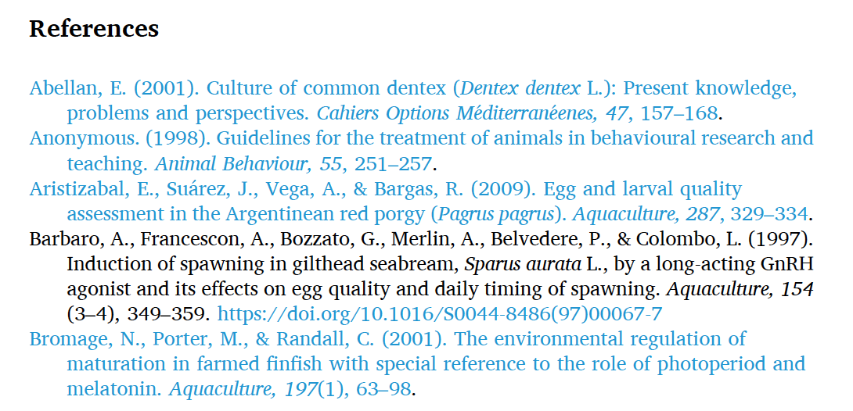
Structure – References (format)
Journals, Books, Chapters, Conferences, Thesis, Reports
Every journal has its own style ! (alphabetical, numerical)
Check Instructions to authors

Slide 22
Structure – References (examples)
Journals
Corriero, A., Wylie, M.J., Nyuji, M., Zupa, R., Mylonas, C.C., 2021. Reproduction of greater amberjack (Seriola dumerili) and other members of the family Carangidae. Reviews in Aquaculture. 13, 1781-1815.
Fakriadis, I., Meiri-Ashkenazi, I., Bracha, C., Rosenfeld, H., Corriero, A., Zupa, R., Pousis, C., Papadaki, M., Mylonas, C.C., 2024. Gonadotropin expression, pituitary and plasma levels in the reproductive cycle of wild and captive-reared greater amberjack (Seriola dumerili). Gen Comp Endocrinol. 350, 114465.
Chapters in Books
Mylonas, C.C., Zohar, Y., Pankhurst, N.W., Kagawa, H., 2011. Reproduction and broodstock management. p. 95-131 In: Sparidae: Biology and Aquaculture of Gilthead Seabream and Related Species. Pavlidis, M., and Mylonas, C.C. (Eds.). Blackwell Science Publishers, London.
Zohar, Y., Mylonas, C.C., 2001. Endocrine manipulations of spawning in cultured fish: from hormones to genes. p. 99-136 In: Reproductive Biotechnology in Finfish Aquaculture. Donaldson, E.M., and Lee, C.S. (Eds.). Elsevier, Amsterdam.
Books (whole)
Pavlidis, M., Mylonas, C.C., 2011. Sparidae: biology and aquaculture of gilthead sea bream and related species. Blackwell Scientific Publishers, London, 390 pp.
Use bibliographic software to prepare the Reference list, to save time and avoid errors!!!!!
Notes:
Notice the different in capitalization in the name of the Books, for the Chapter of Mylonas and the Book of Pavlidis!

Slide 23
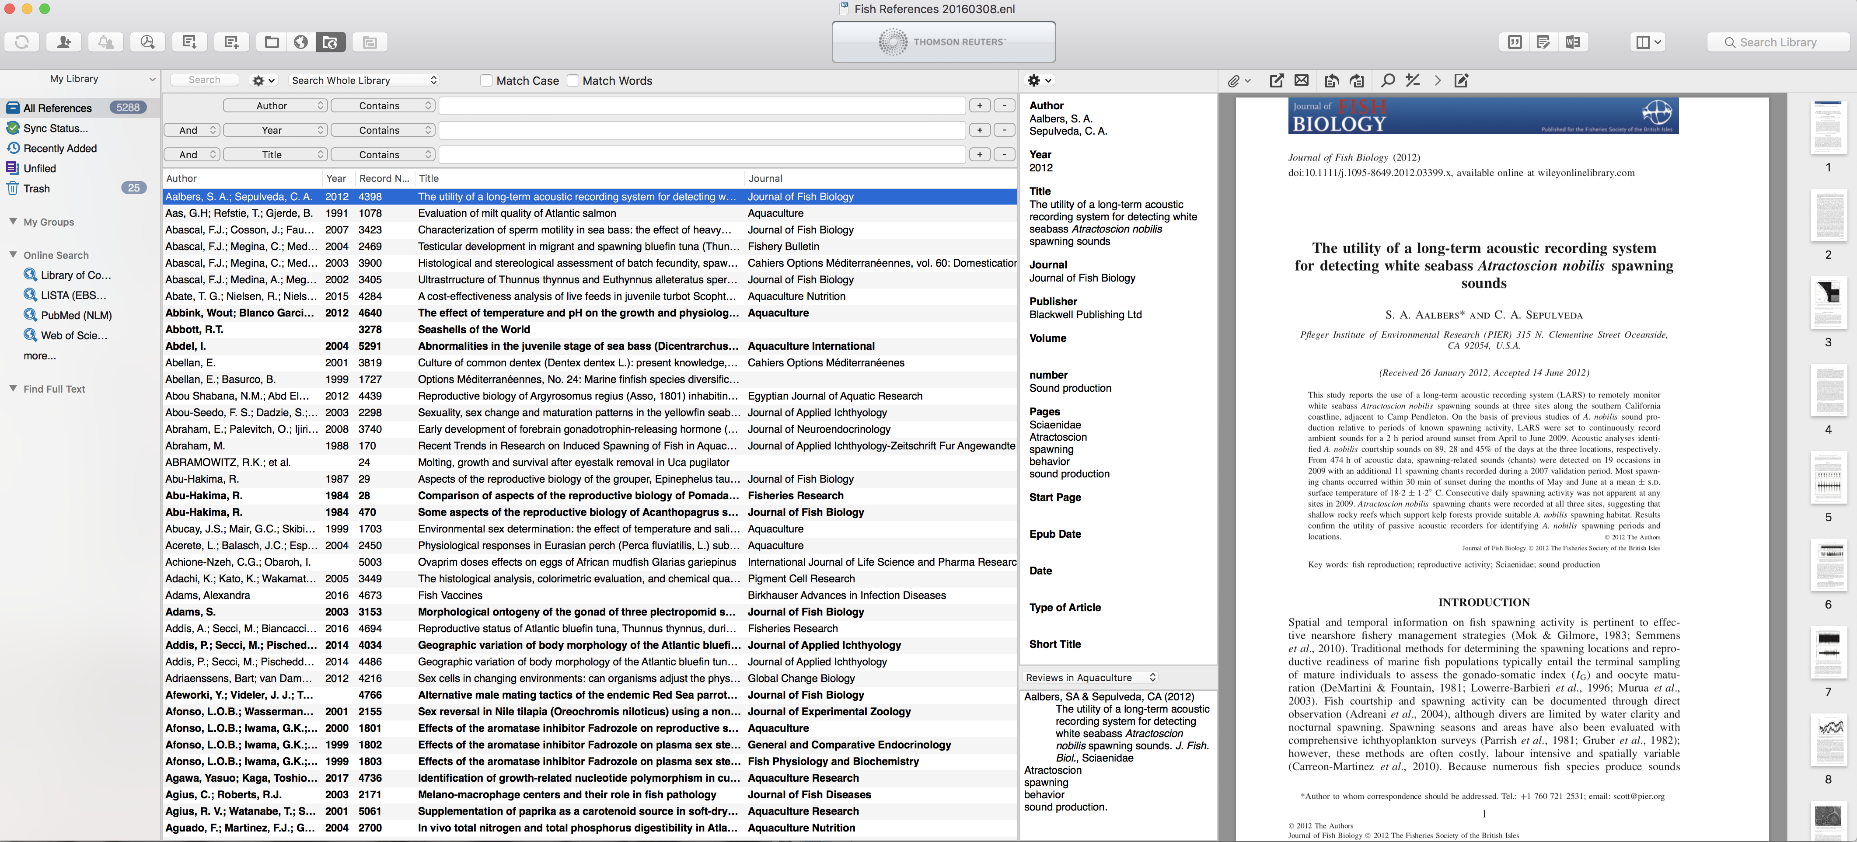
Structure – References 4
Bibliographic software
Endnote, Mendeley, Zotero, etc.
Help you organize/find your articles (data base)
Format References correctly, for different journals
Change format in seconds
more later…..
Notes:
Here, we make a brake and we look at Endnote with an example of a manuscript.

Slide 24
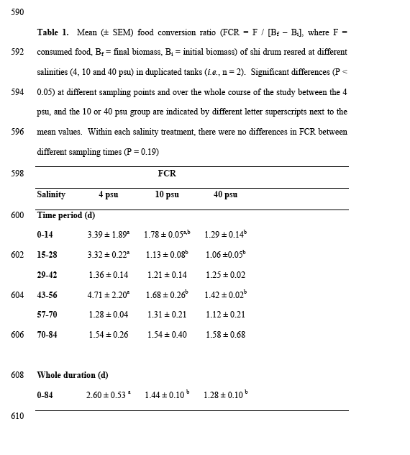
Structure – Tables
Each Table in a separate page (txt), but since it is text, some journals allow you to have in the same document
No vertical borders
Legend ALWAYS above
Self-explanatory (no reference to main text)
Title page (1 page)
Abstract (1 page)
Introduction (2-3 pages)
Materials and methods (n pages)
Results (n pages)
Discussion (3-n pages)
Acknowledgements (1 paragraph)
References (1-n pages, ~50 citations)
Tables (0-7?)
Figures legends
Figures
Notes:
Tables and figure legends may be in the same document or separate. Tables are treated as Text so they are prepared in MS Word, not as a picture. NO vertical lines!

Slide 25
Structure – Tables
Title page (1 page)
Abstract (1 page)
Introduction (2-3 pages)
Materials and methods (n pages)
Results (n pages)
Discussion (3-n pages)
Acknowledgements (1 paragraph)
References (1-n pages, ~50 citations)
Tables (0-7?)
Figures legends
Figures
Notes:
Tables and figure legends may be in the same document or separate. Tables are treated as Text so they are prepared in MS Word, not as a picture. NO vertical lines!

Slide 26
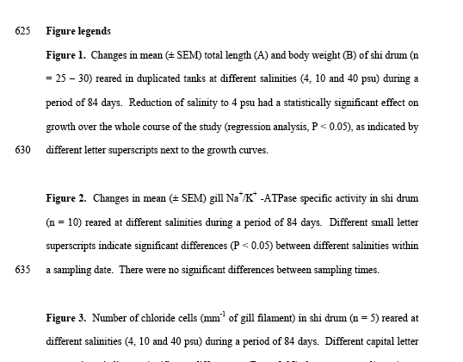
Structure – Figures/graphs
Separate Word file or at the end of the main text (as for Tables)
NO next to the Figure file (which is in TIFF, JPEG or other photo format
Figure legends ALWAYS below the figures
Self-explanatory (no reference to main text)
Title page (1 page)
Abstract (1 page)
Introduction (2-3 pages)
Materials and methods (n pages)
Results (n pages)
Discussion (3-n pages)
Acknowledgements (1 paragraph)
References (1-n pages, ~50 citations)
Tables (0-7?)
Figure legends (0-7)
Figures
Notes:
Tables and figure legends may be in the same document or separate

Slide 27
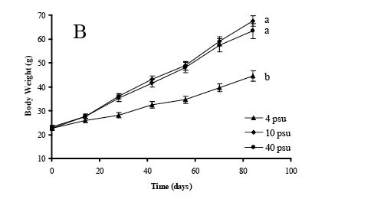
Structure – Figures/graphs
Each Figure in a separate page, preferably in TIFF or JPEG format
NO titles (legends)
Font size at least same as text (12 or 11 point, or at least 10 point. May be reduced by the journal
Title page (1 page)
Abstract (1 page)
Introduction (2-3 pages)
Materials and methods (1-n pages)
Results (n pages)
Discussion (3-n pages)
Acknowledgements (1 paragraph)
References (1-n pages, ~50 citations)
Tables (0-7?)
Figure legends (0-7)
Figures (0-7)

Slide 28
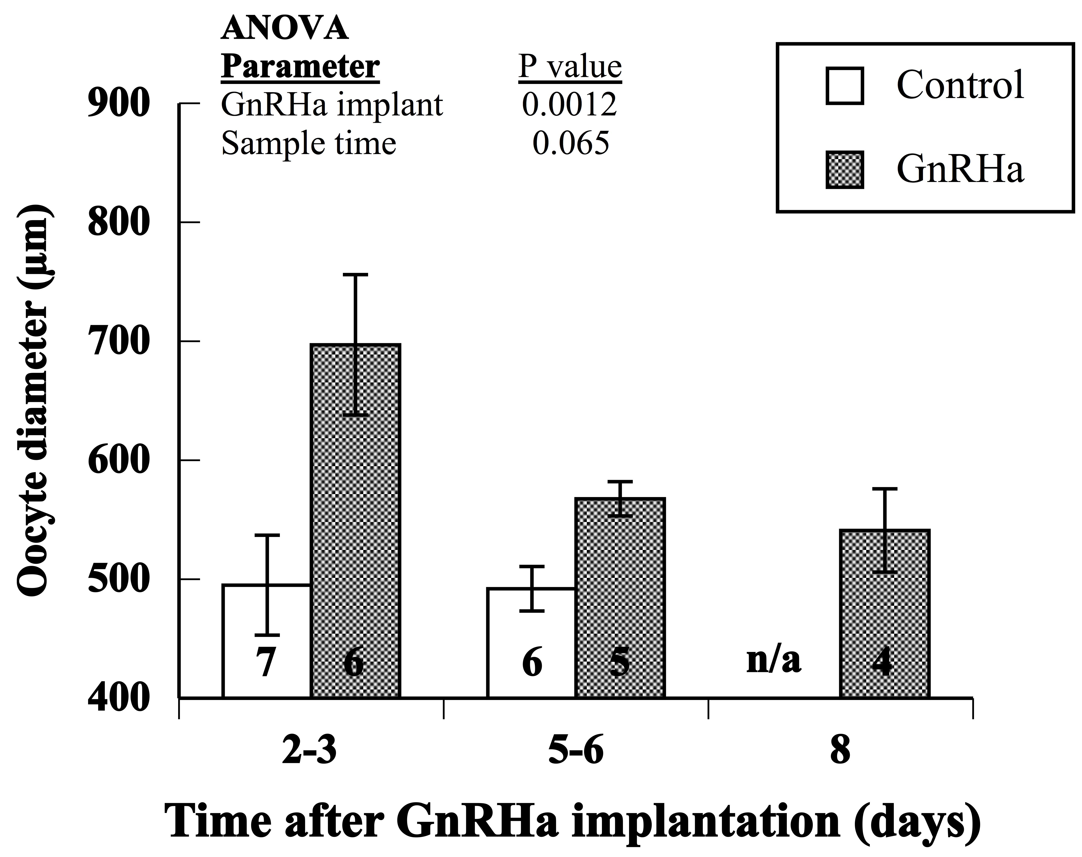
Structure – Figures/graphs

Slide 29
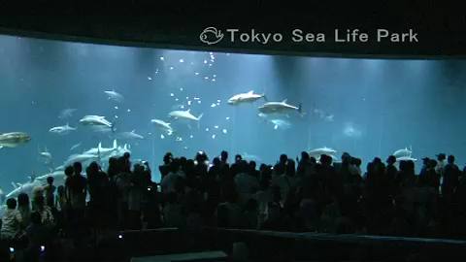
End of Section 1 – short break??
Spawning of Pacific bluefin tuna
Notes:
Insert video of tuna spawning

Slide 30
How to write a scientific article
Outline of todays presentation
Preparation of a manuscript
  Format
  Parts
  Contents
  References
  Tables and Graphs
Language use and common errors
References and Bibliographic software
Table of Contents
Review process

Slide 31
Language – passive voice
Write in passive voice and not in the first person (more formal).
For example:
    (Yes) Blood samples were collected and analyzed using ELISA.
    (No) We collected blood samples and analyzed them using ELISA.
However, some journals suggest to use first person to make the text shorter and more “active”.
Notes:
Avoids using I and We (appear humble) all the time, and removes a bit the responsibility (like a liability statement)

Slide 32
Language – past tense
Write in past tense for the results of an experiment or of another study. Use present tense for well-accepted theories or facts.
For example:
    (Yes) The study indicated that fish reproduced well in captivity.
    (No) The study indicates that fish reproduce well in captivity.
    (Yes) It is known that most temperate zone fishes reproduce once a year in nature
Notes:
The work was done, finished. It was done once, so if it is repeated it is not sure it will give the same results.

Slide 33
Language – stress position
Stress position. A reader expects to see what is important at the end of the sentence.
For example:
1: Introduction of the new assembly line increased manufacturing.
2: Manufacturing increased after the introduction of the new assembly line.
In (1), the study looked at the various effects of the introduction of the new assembly line. The key effect that was observed was an increase in the manufacturing.
In (2), the study looked at various ways to increase manufacturing. Of these, introduction of the new assembly line had the greatest effect.

Slide 34
Language – subject and verb placement
Subject-verb placement. The verb must be near the subject of a sentence. If you insert a lot of text between the subject and the verb, the reader may forget what the subject was.
For example:
(Yes) The patient’s liver readings [subject] had increased [verb] by 50% at 48 hours after exposure to the virus.
(No): The patient’s liver readings [subject] at 48 hours after exposure to the virus had increased [verb] by 50%.

Slide 35
Language – in text citations 1
Avoid using author names out of parentheses. These are better placed in parentheses, unless there is really a need to emphasize the name of the author.
For example:
    (Yes) The gilthead seabream reproduces annually for a period of 3-5 months (Zohar et al., 1995).
    (No) Zohar and coworkers (1995) demonstrated that gilthead seabream reproduces annually for a period of 3-5 months
    (Yes) Contrary to what has been know until now (Johnson et al., 1990; Stevens & Brown, 1991; Holland et al, 1993), Zohar and coworkers suggested recently that not all stocks of gilthead seabream reproduce annually for a period of 3-5 months.
    (Yes) Eistein (1945) was the first to relate energy to mass.

Slide 36
Language – in text citations 2
Citation to a study, table or figure should be done at the end of the sentence, unless this citation refers to only part of the sentence.
For example:
    (Yes) It has been found in both marine and freshwater fish that plasma testosterone increases after a meal and this increase is correlated to increased swimming activity (Stevens, 1978).
    (No) It has been found in both marine and freshwater fish that plasma testosterone increases after a meal (Stevens, 1978) and this increase is correlated to increased swimming activity.
    (Yes) It has been found in both marine and freshwater fish that plasma testosterone increases after a meal (Manabu et al., 2008) and this increase was correlated to increased swimming activity (Johns, 2018).

Slide 37
Language – in text citations 3
After the citation, following sentences referring to the same study do not need to have the citation repeated, unless conflicting data may intervene.
For example:
    It has been found that both marine and freshwater fish have high plasma testosterone (Stevens, 1978). This hormone increased also after a meal and this increase is correlated to increased swimming activity in marine fish only.
    but
    It has been found that both marine and freshwater fish have high plasma testosterone (Stevens, 1978). In the present study of carp, the same was observed after a meal, but it was not correlated to increased swimming activity, as observed in marine fish (Stevens, 1978).
Notes:
In the second example, a statement referring to the present study intervenes, and then again we talk about the work published by Stevens, so we cite it again in order to ensure that it is not us that did the work.

Slide 38
Language – Quoting and paraphrasing
Quoting vs paraphrasing
    (original from Zohar et al., 2001) In conclusion, it seems that seabass responds quite positively to hormonal induction of spawning with the use of GnRHa implants and its hormonal dysfunction related to reproductive failure is thus overcome.
    (quoting) According to Zohar et al. (2001) “seabass responds quite positively to hormonal induction of spawning with the use of GnRHa implants” and …..
    (paraphrasing) In earlier studies, the response of seabass to hormonal induction of spawning was very positive when GnRHa implants were used (Zohar et al., 2001) and …..

Slide 39
Language – Paraphrasing example
Original article
Meagre (Argyrosomus regius) belongs to the family Sciaenidae and is an euryhaline and benthopelagic species, found mostly in lagoons and river deltas of subtropical climates (Griffiths, 1995). It is a gonochoristic species that does not exhibit sexual dimorphism and has been found to mature reproductively in captivity at the age of 2 for males and 3 for females (Schiavone, 2012), although in nature age at maturity has been calculated to be 5 years for males and 6 for females (González-Quirós, 2011;Morales-Nin, 2012).
Homework!!!!!

Slide 40
Language – Paraphrasing example
Paraphrasing
Meagre (Argyrosomus regius) is a member of the Sciaenidae family and can be found in various salinities, often in lagoons and river deltas around the Mediterranean Sea (Griffiths, 1995). Males and females are gonochoristic and do not differ in external characteristics, and males and females reach reproductive maturity at 2 and 3-years-old, respectively (Schiavone, 2012), although age at maturity in nature has been reported to be 5 and 6 years for males and females, respectively (González-Quirós, 2011;Morales-Nin, 2012).
Homework!!!!!

Slide 41
Language – Latin abbreviations
Words that have a Latin origin are usually written in italics.
For example:
In vitro, in silico, a posteriori, ad hoc, ad libitum, i.e, e.g., etc.
Some journals do not require italics for those that are very common (e.g. or in vitro).
To be on the safe side, always write them in italics!

Slide 42
Language – Latin abbreviations
The abbreviations e.g. and i.e. don’t mean the same thing!
    e.g. (exempli gratia “for the sake of example”, «για παράδειγμα»)
    i.e. (id est “that is”, «δηλαδή»)
They are usually in italics and should not be followed by commas.
For example:
    Giving a dose of sex steroids (e.g. Testosterone) is considered a reasonable method for increasing maleness (John et al. 2020).
    Giving a dose of the major androgen steroid (i.e. 11-Ketotestosterone) is considered a reasonable method for increasing maleness (John et al. 2020).

Slide 43
Language – scientific & common names
    Scientific names always in italics, because they are considered to be in Latin. Carolus Linnaeus (as opposed to Carl Linné)
    Canis familiaris, Mus musculus, Sus scrofa, Felis catus
    The common names of animals are always written in small letters (except birds), unless they have main names such as Atlantic, Japanese, Nile, Saint Peters, Williams, etc.
For example:
    Studies have shown that the gilthead seabream grows slower than the European sea bass in the Mediterranean. On the other hand, the Atlantic bluefin tuna swims faster than the yellowfin tuna

Slide 44
Language – scientific & common names
Always mention Scientific names at the first time cited in the Title, Abstract and main text of the manuscript. Then, use common names throughout.
-In some journals, and for some situations, scientific names may be used throughout the manuscript
-Scientific names may be in parentheses or not, after a comma or not, BUT always use the same format throughout the manuscript
For example:
    The gilthead seabream (Sparus aurata) is a much smaller fish than the greater amberjack, Seriola dumerili, which in turn is a much smaller fish than the Atlantic bluefin tuna Thunnus thymus.
Notes:
All three options are possible in different journals, but only one is accepted for each journal.

Slide 45
Language – define abbreviations first
Always define abbreviations at the first time cited in the Abstract and main text of the manuscript. First the full name and then the abbreviation, not the other way around.
For example:
    (Yes) Giving an exogenous dose of testosterone (T) is considered a reasonable method for increasing maleness.
    (No) In the blood, E2 (17b-estradiol) can be elevated during the reproductive season.
Some words are well known, and are not explained any more
e.g. DNA, mRNA, PCR, etc.
Notes:
Polymerase Chain Reaction (PCR)

Slide 46
Language – starting a sentence
Never start a sentence with an abbreviation or an Arabic number. Spell them out even if already defined.
For example:
    (Yes) Luteinizing hormone is the main gonadotrophin in mammals, controlling gametogenesis.
    (No) LH is the main brain hormone in mammals, controlling reproduction.
    (Yes) Twenty-five percent of the population in Greece own a second house.
    (No) 25 fish were sampled at each monthly sampling.

Slide 47
Language – which or that?
"Which" and "that” do not have the same meaning.
“Which” indicates cause-effect and it must be preceded by a comma. “That” is more for additional information and does not need a comma.
For example:
    (yes) Fish did not respond to the treatment, which means that they were not mature yet.
    (yes) Fish did not accept the second type of food that was prepared with marine oils.

Slide 48
Language – “such as” not “like”
Use “such as” as opposed to “like” to mean “similar to”.
”Like” is a verb meaning “to enjoy or approve of something or someone”.
For example:
    (yes) There are other hormones that are more relevant to reproduction, such as Testosterone and Estradiol.
    (no) There are other hormones that are more relevant to in reproduction, like Testosterone and Estradiol.
Notes:
This is for technical writing. It can be used as a preposition in literary writing
like preposition, conjunction (SIMILAR TO)

Slide 49
Language – High vs Large, low vs small
“High” and “low” are used for levels or numerical values.
“Large” and “small” are used for changes in size, dimensions or mass (but without values).
For example:
(Yes): Higher plasma testosterone levels were obtained after hormonal therapy.
(No): Larger plasma testosterone levels were obtained after hormonal therapy
(Yes): A small amount of the brain’s capacity is needed for survival instincts.
(No): A low amount of the brain’s capacity is needed for survival instincts.

Slide 50
Language – “respectively”
‘Respectively’ is an adverb that is used to mean “in the order given” and can be used to avoid repetition and reduce the length of a sentence.
For example:
The tubes containing blood were labeled B and those containing saline were labeled S and those containing urine were labeled U. (no need for “respectively”)
The tubes containing blood, saline and urine were labeled B, S and U, respectively.

Slide 51
Language – numerals
Spell out numbers from one to nine, if they are not followed by units, and use Arabic numbers for those above 10.
For example:
    (Yes) In the present study 9 tanks (units) were used in each of the five therapies used for the study.
    (Yes) The experiments were repeated at 12 different times during the period of 3 years (units).

Slide 52
Language – list of terms
In a list of terms, all must be in the same form (verbs, nouns, etc.).
For example:
    (Yes) The objective was to study behaviour, describe form and develop new methods. (all verbs)
    (Yes) The objective was the study of behavior, the description of form and the development of new methods. (all nouns)
    (No) The objective was to study behavior, describe form and the development of new methods.

Slide 53
Language – list of terms
In a list of terms with finite terms, the last one is connected with "and" or “, and” (both OK, be consistent),
For example:
    (Yes) It has been found that fish have three steroids in their plasma during reproduction: testosterone, estradiol (,) and dihydroxyprogesterone.
In a list of terms with infinite terms, add et cetera (etc.) after the last term (means “and other things”)
For example:
    (Yes) It has been found that fish have many steroids in their plasma during reproduction: testosterone, estradiol, dihydroxyprogesterone, etc.
Notes:
Et cetera ”and other similar things”

Slide 54
Language – space between numbers and units
Unless specifically requested in the Instructions to Authors, always leave a space between the number and unit
for example, 10 Kg, 4 min, 9 h,
except in the case of temperature degrees and percentage
for example, 34ºC and 20%

Slide 55
Language – miscellaneous
The comma is placed next to the last letter, not the following letter
For example:
    (Yes) It has been found that fish have many steroids in their plasma during reproduction, but they differ between males and females
    (No) It has been found that fish have many steroids in their plasma during reproduction ,but they differ between males and females
A single sentence cannot constitute a paragraph. Either expand further or consolidate with another paragraph.
Use units with the IU standards (mg l⁻¹ not ml/l), but follow format of journal.

Slide 56
How to write a scientific article – Preparation sequence
Prepare the Title page (This will form the “theme” of the paper) Beginning is half of everything!!!!!!
Prepare Graphs and Tables (This will create the “story or content” of the paper)
3. Start writing the manuscript
- Materials & methods
- Results
- Introduction (based on the Results you will build the background, justification of the study and its objectives)
- Discussion (interpret the results, relate to the current knowledge, suggest and justify further research, draw conclusions)
- References
4. Abstract
5. Read again, and again, and again

Slide 57
Authorship rules!
The corresponding author is the director of the lab, who will be always available to respond to any request regarding the article
The person who writes the paper, gets 1st author
The person who pays for the work gets last author
The person who thought of the work gets 1st or last author (depending on the writing contribution)
If you are an author, you should be able to explain and defend the paper
Technicians may or may not be co-authors, depending on their involvement, contribution or policy
Sequence according to individual contribution

Slide 58
How to write a scientific article
It always takes longer than you think!!!
Καλή επιτυχία!

Slide 59
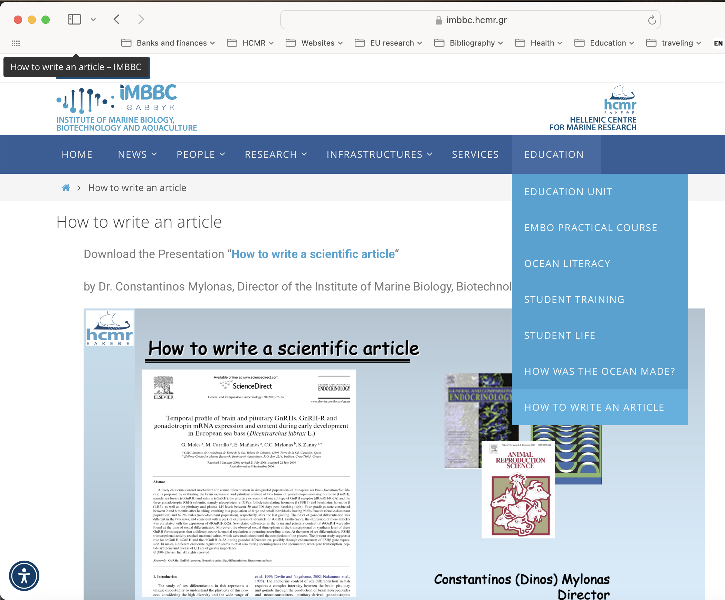
How to write a scientific article
imbcc.hcmr.gr
Outline of todays presentation
Preparation of a manuscript
  Format
  Parts
  Contents
  References
  Tables and Graphs
Language use and common errors
References and Bibliographic software
Table of Contents
Review process

Slide 60
How to write a scientific article
Outline of todays presentation
Preparation of a manuscript
  Format
  Parts
  Contents
  References
  Tables and Graphs
Language use and common errors
References and Bibliographic software
Table of Contents
Review process

Slide 61
How to write a scientific article
Outline of todays presentation
Preparation of a manuscript
  Format
  Parts
  Contents
  References
  Tables and Graphs
Language use and common errors
References and Bibliographic software
Table of Contents
Review process

Slide 62
How to write a scientific article
Constantinos (Dinos) Mylonas
Director
Institute of Marine Biology, Biotechnology & Aquaculture
Crete, Greece
mylonas@hcmr.gr

