Slide 1


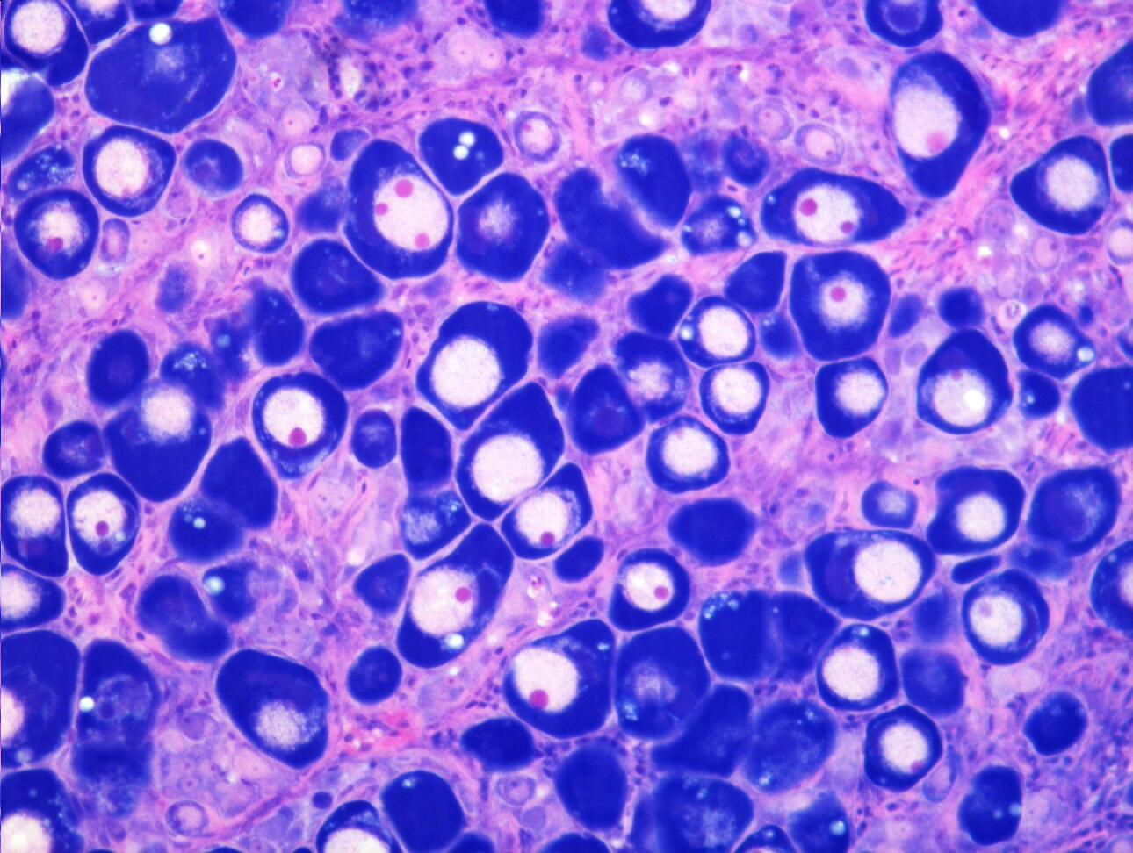
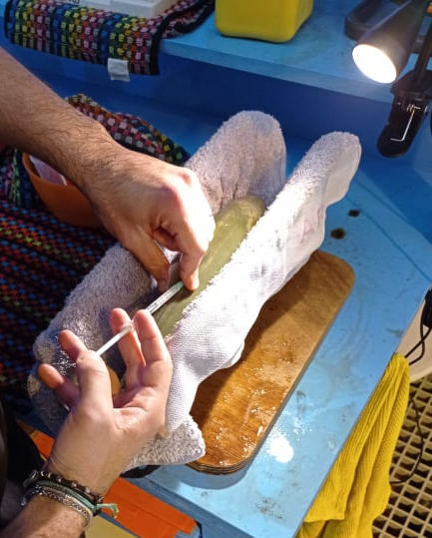
Do not put any information outside this dotted box
The title of the slide should be in 32-36 points
Start the sentence with a capital letter
Allow ~1 cm of margin around the slide, to avoid information being lost due to problems with the projector or screen size.
Use wide screen format (33.78 x 19.05 cm)
All information should be legible (text minimum 20 point, bold or regular).
Size 18 point may be OK sometimes, when there is not too much text together
Figure labels and units, may be up to 16 point, preferable bold

Slide 2
Do not put any information outside this dotted box
Writing in all capitals, is OK for titles ONLY.
Start the sentence with a capital letter
Do not put too much information or items to which you will not refer.
Observers will stop paying attention, if
  (a) cannot see the information (too small font), or
  (b) cannot have enough time to read it
Better use light background (e.g. white, grey) with dark text (e.g. black, blue)
Avoid using too many colors for text. Some will not show well in a projector (compared to computer screen), especially on a dark background
Presentations should include 1 slide per minute of presentation (as a rule-of-thumb) plus 2 min for Q&A

Slide 3


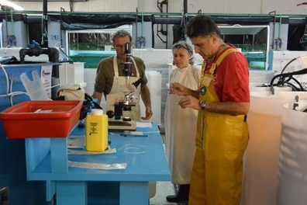
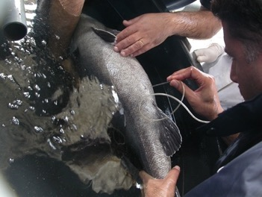
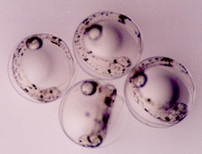


Αναπαραγωγή ιχθυων στην μεσογειο θαλασσα
Κωνσταντίνος Μυλωνάς
Ινστιτούτο Θαλάσσια Βιολογίας, Βιοτεχνολογίας και Υδατοκαλλιεργειών
Ελληνικό Κέντρο Θαλασσίων Ερευνών
Notes:
Thank you very much, It is a real pleasure for me to be here and present some information about the reproduction of Mediterranean fish in aquaculture.

Slide 4

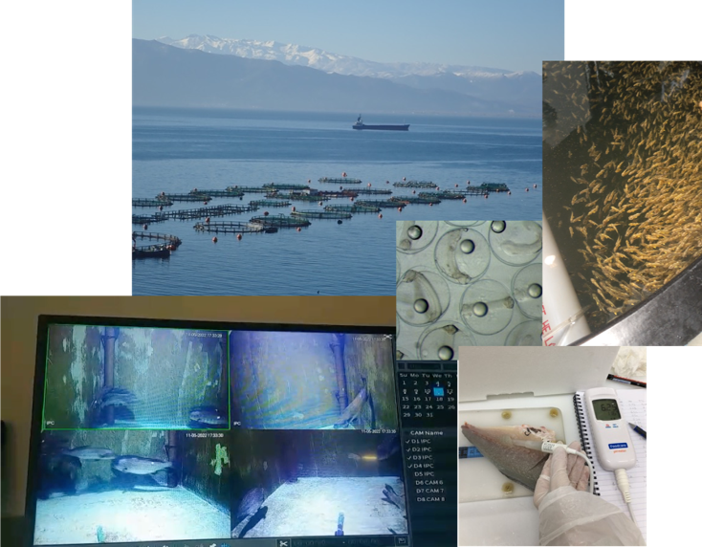








Institute of Marine Biology, Biotechnology & Aquaculture
The Aquaculture Research Group
Reproduction and Physiology
Fish nutrition and feeding
Production technologies
Fish health
Fish behavior
Biomarkers and bioassays
Fish quality and safety
Aquaculture genetics
Notes:
Thank you very much, It is a real pleasure for me to be here and present some information about the reproduction of Mediterranean fish in aquaculture.

Slide 5
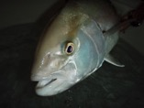

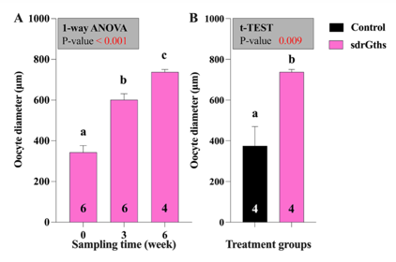
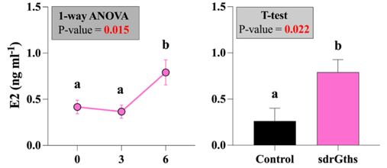
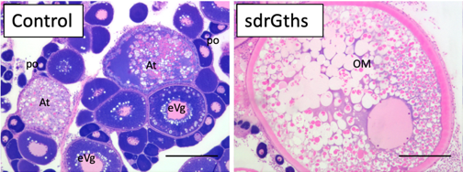
Enhancement of gametogenesis
- using recombinant sdrFsh and Lh (sdrGths)
sdrFsh/LH induced vitellogenesis and maturation
Aquaculture 594 (2024) 741401
Notes:
Looking at the oocyte diameters (LEFT), which is directly related to the process of vitellogenesis, we see gradual and significant increases in response to the recombinant Fsh/Lh treatment. At the completion of the 6 weeks, recombinant hormone-treated females had post vitellogenic oocytes, that were greatly larger than controls. This stimulation of vitellogenesis was correlated with significant increases in plasma Estradiol (RIGHT), which is the sex steroid hormone controlling vitellogenesis in fish. In fact, at the end of the recombinant hormone treatment, females already started to undergo oocyte maturation, before even treating them with the GnRHa implant, as shown here by this ovarian histology section.

Slide 6

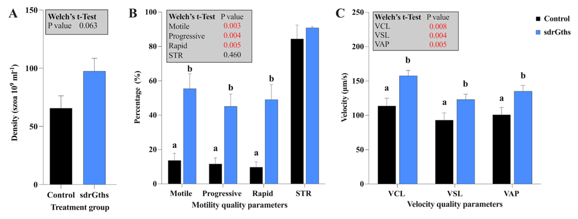
Enhancement of gametogenesis
- using recombinant sdrFsh and Lh (sdrGths)
sdrFsh/LH enhanced spermiation and improved sperm quality
Aquaculture 594 (2024) 741401

Slide 7
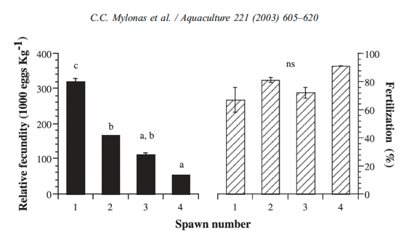
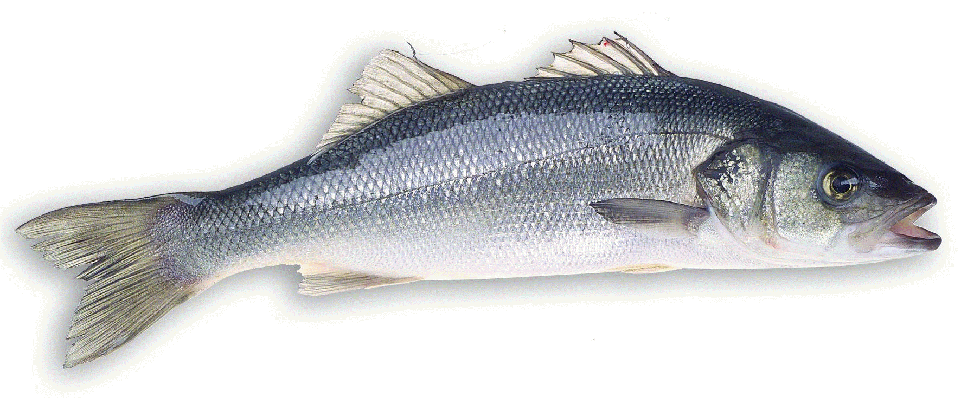
European seabass (Dicentrarchus labrax)
- multiple batch spawner (gonochoristic)
GnRHa injections
Spawning interval: 5-20 days
Spawning period: 2 months (Jan-Mar)
Fecundity: 600,000 eggs kg⁻¹ year⁻¹
Notes:
The European sea bass, is the other important species in Mediterranean aquaculture. It is a gonochoristic species, with multiple spawning, producing 3-5 spawns every year, with an interval between spawns of many days to a few weeks, during a 2-month spawning period. You can see that spawning is not very well synchronized, posing problems in the hatchery planning as it cannot be known how many fish will spawn and how many eggs will be produced at a given day.
Also, if you look at the number of spawning fish (LEFT) or parentage contribution, it is quite variable and, male participation can be only 25% in some spawns.
1-ANIMATION:
When we induce seabass to spawn using 4 repeated, single injections of GnRHa, we can obtain up to 4 spawns, each with about ½ the fecundity of the previous spawn. So, if we want to increase egg production in our hatcheries, we need to synchronize the fish, and try to get the first or second spawn of each fish to maximize egg batch for larval rearing.

Slide 8
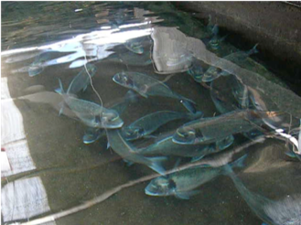
Gilthead seabream (Sparus aurata)
- daily spawner (protandrous hermaphrodite)
Spawning interval:
1-2 days
Spawning period:
4-6 months
Fecundity:
3,000,000 eggs kg⁻¹ year⁻¹
Notes:
The gilthead seabream is the MAJOR species of interest in the Mediterranean, and it is THE ONLY ONE that has been fully domesticated and adapted to the culture environment, spawning quite readily in captivity! It is a protandrous hermaphrodite fish, with almost daily spawning activity, producing very large numbers of eggs over a long spawning season. This species is now cultured outside the Mediterranean, including the Red Sea and the Americas (USA and Caribbean)….

Slide 9

Control of reproduction in aquaculture
- career objectives
Study reproductive cycles
Identify dysfunctions in captivity
Develop methods to control reproduction
      exogenous hormonal therapies
environmental manipulations
Eventually, through domestication and proper management, captive broodstocks should undergo maturation and spawning volitionally
Notes:
SO, in my presentation I tried to acquaint you with the main marine fish we work in the Mediterranean, for aquaculture purposes and to give you an idea of their reproductive biology, the problems we face when we rare them in captivity and the methods we have developed to control better reproductive function.
Starting first with pharmacological/hormonal methods for inducing maturation and spawning, we always try to learn more about their requirements and eventually use only environmental manipulations to ensure that the fish spawn spontaneously without the need for any exogenous hormones.

Slide 10
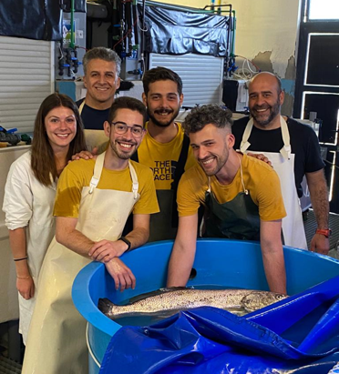

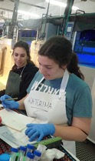

Αναπαραγωγή ιχθυων στην μεσογειο θαλασσα
Dr. Ioannis Fakriadis
Stefano Lancerotto, PhD cand.
Christos Siapazis, MSc
Andrea Meloni, MSc
Katerina Samiotaki, MSc
Maria Papadaki, PhD cand.
Irini Sigelaki, TEI
Κωνσταντίνος Μυλωνάς
ΕΛΚΕΘΕ
Notes:
With this, I would like to acknowledge the contribution to this work of my colleague Dr Ioannis Fakriadis, my two technicians Maria Papadaki and Irini Sigelaki and a number of Masters and PhD students that did their research with us.

Slide 11
Εισαγωγή
Κατά τα νυμφικά στάδια, τα ψάρια υφίστανται σημαντικές αλλαγές στη μορφολογία και τη συμπεριφορά τους
(Koumoundouros et al., 1999a)
Η γνώση της οστεολογικής ανάπτυξης συμβάλλει:
στον ποιοτικό έλεγχο των ψαριών
στην αξιολόγηση των συνθηκών εκτροφής
(Eissa et al., 2021)
Η διατροφή είναι ένας από τους πιο σημαντικούς παράγοντες που επηρεάζουν την οντογένεση του σκελετού των ψαριών και επομένως μπορεί να ευθύνεται για την ανάπτυξη σκελετικών παραμορφώσεων

Slide 12
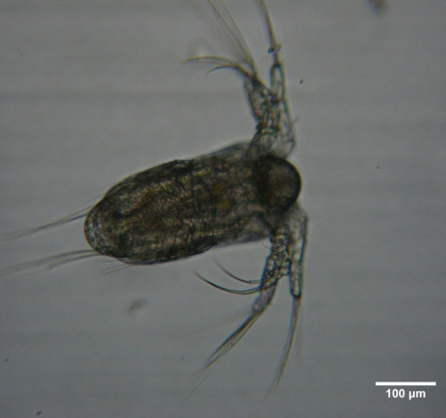
Εισαγωγή
Τα κωπήποδα:
αποτελούν σημαντικό μέρος της φυσικής διατροφής των ιχθυονυμφών
Εικόνα 1: Ναύπλιος Acartia tonsa
υψηλότερη διατροφική αξία από εμπλουτισμένα τροχόζωα και Artemia (Conceição et al., 2010)
ΔΕΝ χρειάζονται εμπλουτισμό → ΔΕΝ επιβαρύνουν την επιφάνεια των δεξαμενών με επιπλέον λίπος
υψηλή περιεκτικότητα σε ελεύθερα αμίνοξέα που βελτιώνουν την αύξηση και την οντογένεση
(Finn et al., 2002; Rønnestad and Conceição 2005)
υψηλή περιεκτικότητα σε ακόρεστα λιπαρά οξέα (HUFAs) στα φωσφολιπίδια → πιο διαθέσιμα και εύπεπτα
(Rønnestad et al., 2013)
χαμηλό βακτηριακό φορτίο (Verner – Jeffreys et al., 2003)

Slide 13
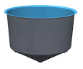
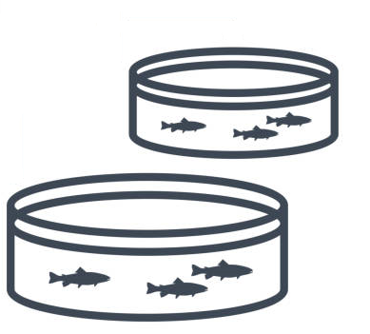
Υλικά & Μέθοδοι
100 mL/ημέρα
Tetraselmis suesica
Isochrysis galbana
Rhodomonas baltica
3 ταϊσματα/ημέρα
Ομάδα Control
Ομάδα Copepods
Δειγματοληψίες
100 L, 100 ιχθυονύμφες/L
Οντογένεση → 10 ψ/δεξ.
DAH – Days After Hatching – Ημέρες μετά την εκκόλαψη
Παραμορφώσεις → 50 ψ/δεξ.
DAH | 1 | 2 | 3 | 4 | 5 | 6 | 7 | 8 | 9 | 10 | 11 | 12 | 13 | 14 | 15 | 16 | 17 | 18 | 19 | 20 | 21 | 22 | 23 | 24 | 25
Control |  |  | Τρ |  |  |  |  |  |  |  |  |  |  |  |  | Τρ +A0 |  | Τρ + A0 + A1 |  |  | Τρ + A1
Copepods |  |  | Τρ + Κωπ |  |  |  |  |  |  |  |  |  |  |  |  | Κωπ + Τρ + A0 |  | Τρ + A0 + A1 |  |  | Τρ + A1

Slide 14
Τα ψάρια που τράφηκαν και με κωπήποδα είχαν καλύτερη οντογένεση σκελετού
πιο άφθονα στα κωπήποδα
ΓΙΑΤΙ ?
Φωσφολιπίδια
Παραμορφώσεις
Μικροθρεπτικά
Σίδηρος
Ιώδιο
Σελήνιο
Χαλκός
Μαγνήσιο
Ασβέστιο
(Cahu et al., 2003)
πιο άφθονα και απορροφούνται εύκολα στα φωσφολιπίδια παρά στα προϊόντα εμπλουτισμού
Βελτιώνουν την οντογένεση του σκελετού
Ελεύθερα αμινοξέα
Παραμορφώσεις
(Cahu et al., 2003)
(Hamre et al., 2013; Li and Olsen 2015; Malzahn et al., 2022)
Λιπαρά Οξέα
Γρηγορότερη οντογένεση (Lund et al., 2018)
Επηρεάζει την έκφραση ορισμένων γονιδίων
Alp
οντογένεση σκελετού
Βέλτιστη αναλογία DHA/EPA: 2.2 – 2.4
Εμπλουτισμένα Τροχόζωα: 2.8
Twist2
πρώιμη ανάπτυξη του σκελετού
DHA/EPA ~ 2
Εμπλουτισμένη Artemia: 1.4
Mef2c
ασβεστοποίηση
Κωπήποδα: 1.8
Sox9
ανάπτυξη του σκελετού, παραμορφώσεις
(El Kertaoui et al. 2019)
(Lund et al., 2018)

Slide 15
Βιβλιογραφικές Αναφορές
Conceição, L. E. C., Yúfera, M., Makridis, P., Morais, S., & Dinis, M. T. (2010). Live feeds for early stages of fish rearing. Aquaculture Research (Vol. 41, Issue 5, pp. 613–640). https://doi.org/10.1111/j.1365-2109.2009.02242.x
Eissa, A. E., Abu-Seida, A. M., Ismail, M. M., Abu-Elala, N. M., & Abdelsalam, M. (2021). A comprehensive overview of the most common skeletal deformities in fish. Aquaculture Research (Vol. 52, Issue 6, pp. 2391–2402). Blackwell Publishing Ltd. https://doi.org/10.1111/are.15125
El Kertaoui, N., Lund, I., Assogba, H., Domínguez, D., Izquierdo, M. S., Baekelandt, S., Cornet, V., Mandiki, S. N. M., Montero, D., & Kestemont, P. (2019). Key nutritional factors and interactions during larval development of pikeperch (Sander lucioperca). Scientific Reports, 9(1). https://doi.org/10.1038/s41598-019-43491-1
Finn, R.N., Wamboldt, M., Fyhn, H.J., 2002a. Differential processing of yolk proteins during hydration in marine fishes (Labridae) that spawn benthic and pelagic eggs. Mar. Ecol. Prog. Ser. 237, 217–226.
Hamre, K., Yúfera, M., Rønnestad, I., Boglione, C., Conceição, L. E. C., & Izquierdo, M. (2013). Fish larval nutrition and feed formulation: Knowledge gaps and bottlenecks for advances in larval rearing. Reviews in Aquaculture, 5(SUPPL.1). https://doi.org/10.1111/j.1753-5131.2012.01086.x
Koumoundouros, G., Divanach, P., Kentouri, M. (1999a). Ontogeny and allometric plasticity of Dentex dentex (Ostheichtyes: Sparidae) in rearing conditions. Mar. Biol. 135, 561–572.
Li, K., & Olsen, Y. (2015). Effect of enrichment time and dietary DHA and non-highly unsaturated fatty acid composition on the efficiency of DHA enrichment in phospholipid of rotifer (Brachionus Cayman). Aquaculture, 446, 310–317. https://doi.org/10.1016/j.aquaculture.2015.05.005
Lund, I., El Kertaoui, N., Izquierdo, M. S., Dominguez, D., Hansen, B. W., & Kestemont, P. (2018). The importance of phospholipids combined with long-chain PUFA in formulated diets for pikeperch (Sander lucioperca) larvae. British Journal of Nutrition, 120(6), 628–644. https://doi.org/10.1017/S0007114518001794
Malzahn, A. M., Ribičić, D., Hansen, B. H., Sarno, A., Kjørsvik, E., Aase, A. S. N., Musialak, L. A., García-Calvo, L., & Hagemann, A. (2022). First feed matters: The first diet of larval fish programmes growth, survival, and metabolism of larval ballan wrasse (Labrus bergylta). Aquaculture. 561. https://doi.org/10.1016/j.aquaculture.2022.738586
Rønnestad, I. & Conceição, L.E.C. (2005) Aspects of protein and amino acids digestion and utilization by marine fish larvae. in Physiological and Ecological Adaptations to Feeding in Vertebrates (ed. by J.M. Starck & T.Wang), pp. 389 - 416. Science Publishers, NH, USA
Rønnestad, I., Yúfera, M., Ueberschär, B., Ribeiro, L., Sæle, Ø., & Boglione, C. (2013). Feeding behaviour and digestive physiology in larval fish: Current knowledge, and gaps and bottlenecks in research. Reviews in Aquaculture. 5(SUPPL.1). https://doi.org/10.1111/raq.12010.
Verner-Jeffreys, D.W., Shields, R.J., Birkbeck, T.H. (2003). Bacterial influences on Atlantic halibut Hippoglossus hippoglossus yolk-sac larval survival and start-feed response. Dis. Aquat. Org. 56, 105–113

Slide 16
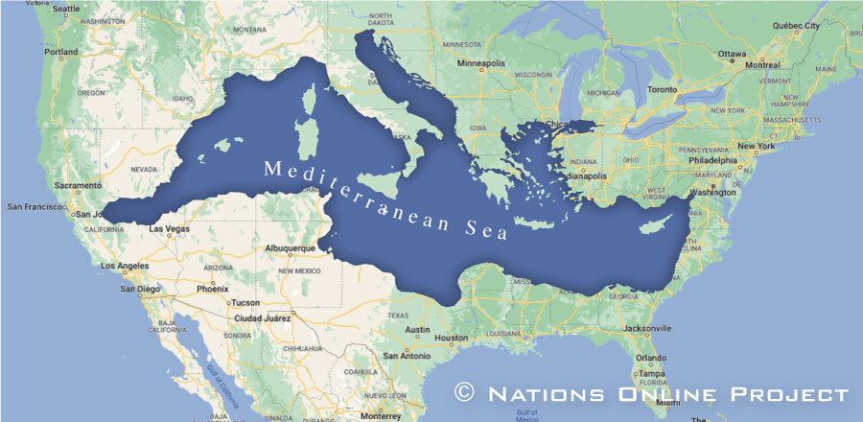
Mediterranean,
A special sea
Closed Sea
22 nations, in 3 continents, 46.000 km coastline, 480 m. people
hotspot for climate change with faster increase of temperature (0.61°C/decade – vs 0.11°C worldwide).
Many human presures
Many invasive species

Slide 17
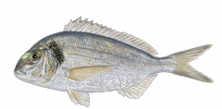
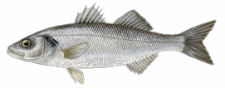
The Mediterranean and aquaculture
The main species cultured are gilthead seabream and European seabass
244.186 mtn in 2023
236.332 mtn in 2023

Slide 18
Animal production
 | beef | chicken | pork | seabass
Times to slaughter | 18–24 mo | 6–8 wks | 5–6 mo | 18–24 mo
(FCR) | 6–10 | 1,5–2,0 | 2,7–3,5 | 1,5–2,5
Dres-out | ~45% | ~70% | ~55–60% | ~50% (fillet)
Environmental footprint | High | Low-medium | Medium-high | Medium

Slide 19
Programme ROBUST
Ιούνιος 2019 – Σεπτέμβριος 2024
ΕΛΚΕΘΕ, ΠΚ, ΙΚ, ΓΘΚ
Μελέτη της παθολογίας/επιδημιολογίας
Ανάπτυξη και μελέτη αποτελεσματικότητας αυτεμβολίων
Φαγοθεραπεία

Slide 20
The meaning of epidemiological unit
Μια ομάδα ζώων με καθορισμένη επιδημιολογική σχέση, τα οποία έχουν περίπου την ίδια πιθανότητα έκθεσης σε έναν παθογόνο παράγοντα.
Αυτό μπορεί να οφείλεται στο ότι μοιράζονται το ίδιο περιβάλλον (π.χ. ζώα στον ίδιο κλωβό ή δεξαμενή) ή σε κοινές πρακτικές διαχείρισης
Στην Μεσογειακή ιχθυοκαλλιέργεια Ε.Μ. θα μπορούσε να είναι μια μονάδα ιχθυοκαλλιέργειας, ένας κόλπος στον οποίο συνυπάρχουν περισσότερες από μία μονάδες, μια ευρύτερη περιοχή, μια ολόκληρη χώρα

